Slide 1

THE INVISIBLE ENEMIES
Notes:
Hey everyone!

Slide 2
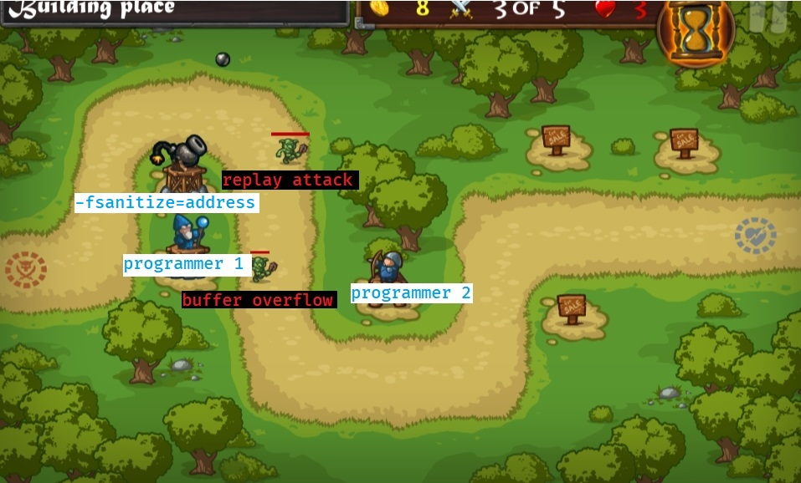
Some introduction pages…
Notes:
The defensive mindset

Slide 3

Going offensive
Notes:
Going offensive

Slide 4
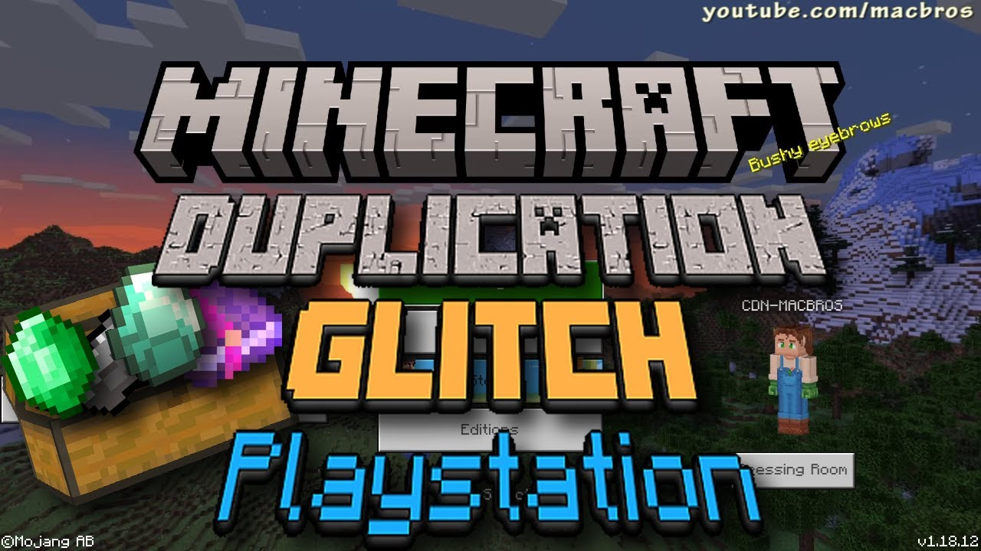
Notes:
Vulnerabilities

Slide 5
Some definitions
A vulnerability is a bug that presents security problems.
By attacking a program, you use, or exploit, its vulnerabilities to do things undesired or unexpected of the program.
An attack is a way to break a security defense by exploiting a vulnerability.
An exploit is a program that chains attacks to break another program.
And a mitigation is a security measure designed to prevent, or at least harden, vulnerability exploitation. Usually by fixing a bug.
Notes:
You (and the things you love) are under attack!

Slide 6



Common targets
Notes:
Common targets

Slide 7

First, we’ll cover some theory on common vulnerabilities and attacks.
Then we’ll turn to practice and actually break a small program to show how it’s done!
Finally, we’ll tell you how you can reduce damage from attacks or avoid them altogether.
Notes:
How do they do it?

Slide 8
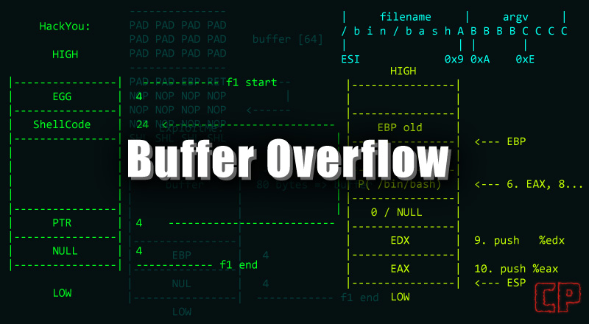

Slide 9
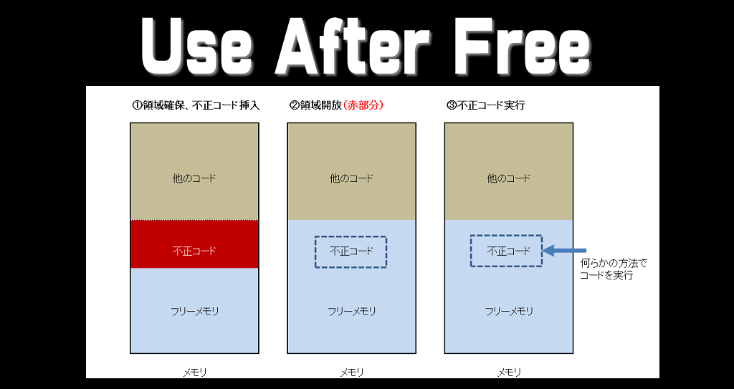

Slide 10
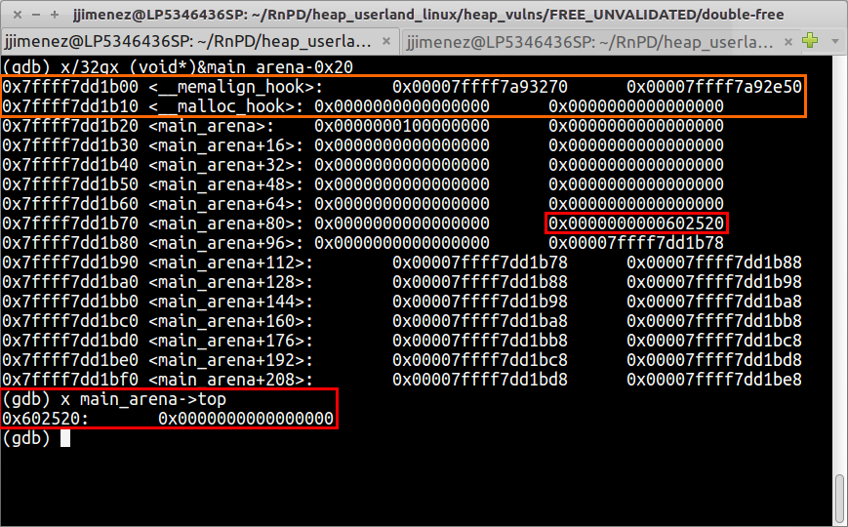
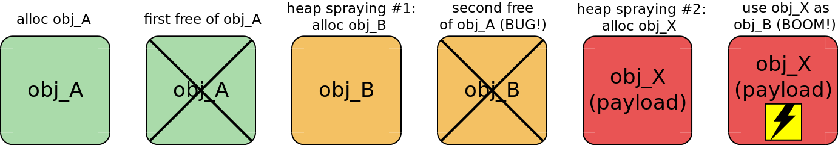
Notes:
Double free

Slide 11
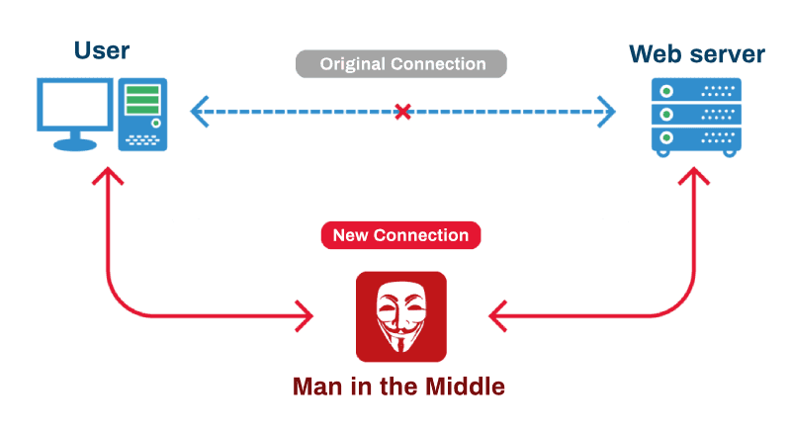
Notes:
MINM

Slide 12
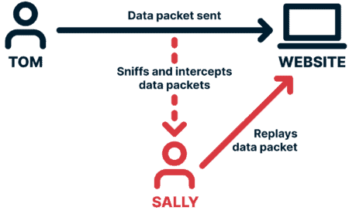
Notes:
Replay attack

Slide 13
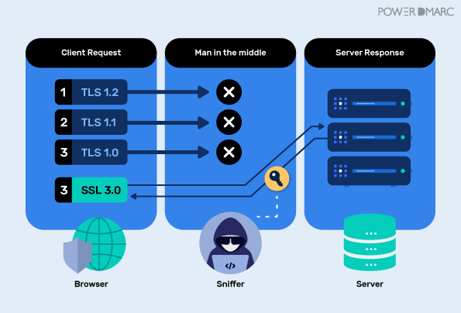

Slide 14
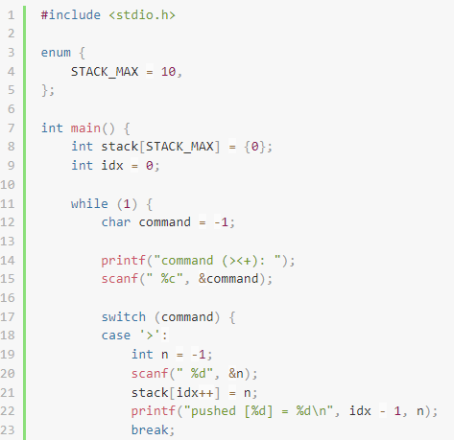
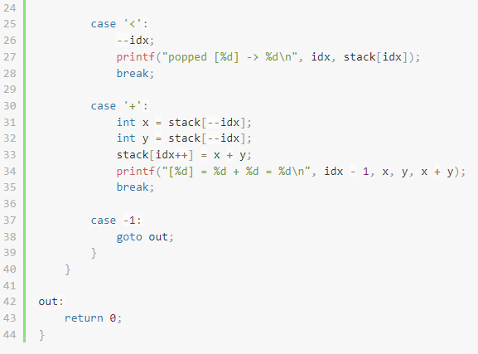
Hacking apart… a calculator

Slide 15
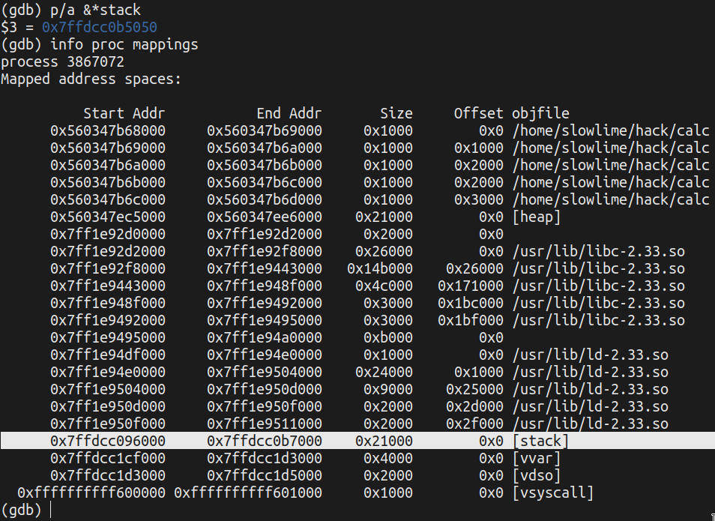
Extracting the required data

Slide 16
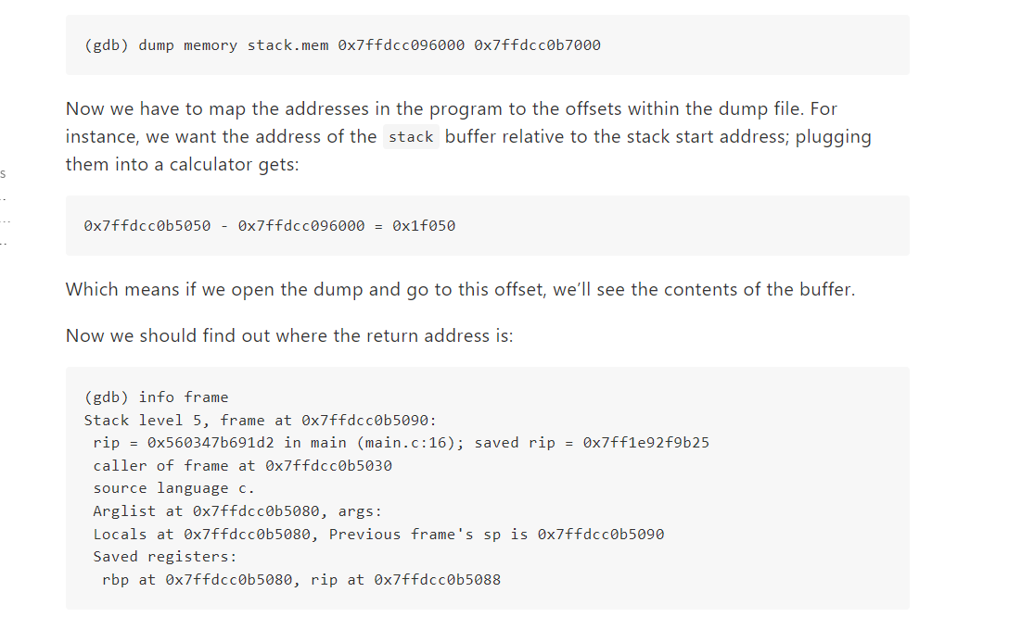
Notes:
Some explanations…

Slide 17
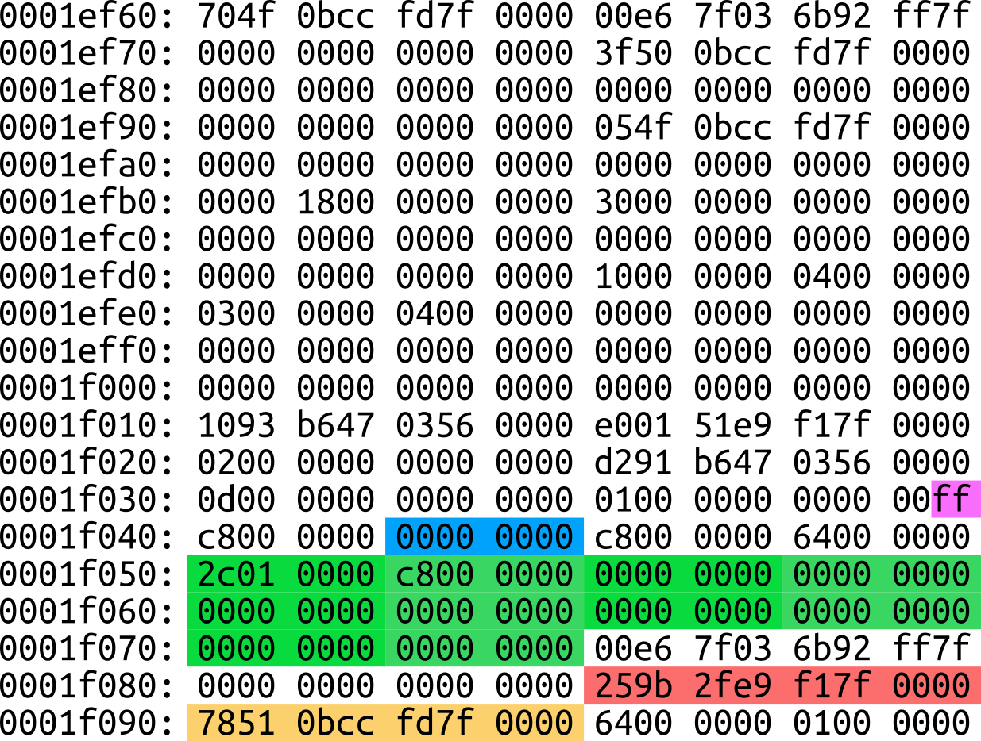

Slide 18
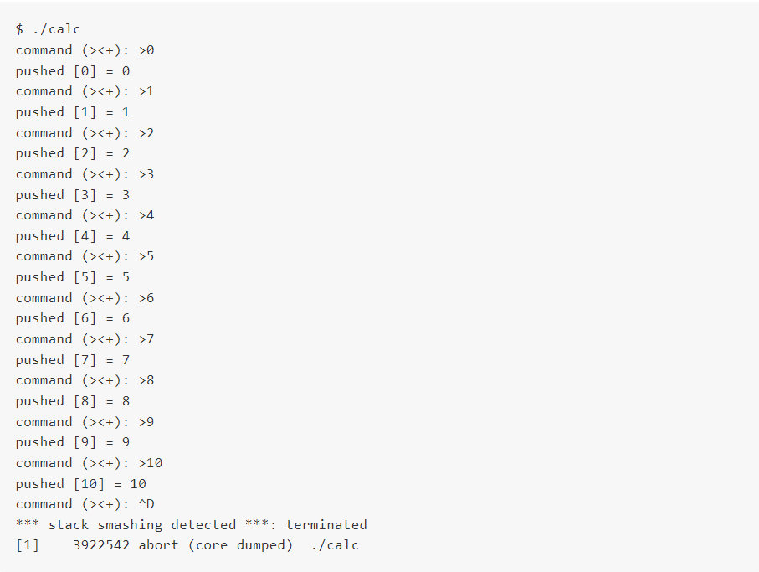
Something went wrong

Slide 19

Notes:
THE CULPRIT

Slide 20
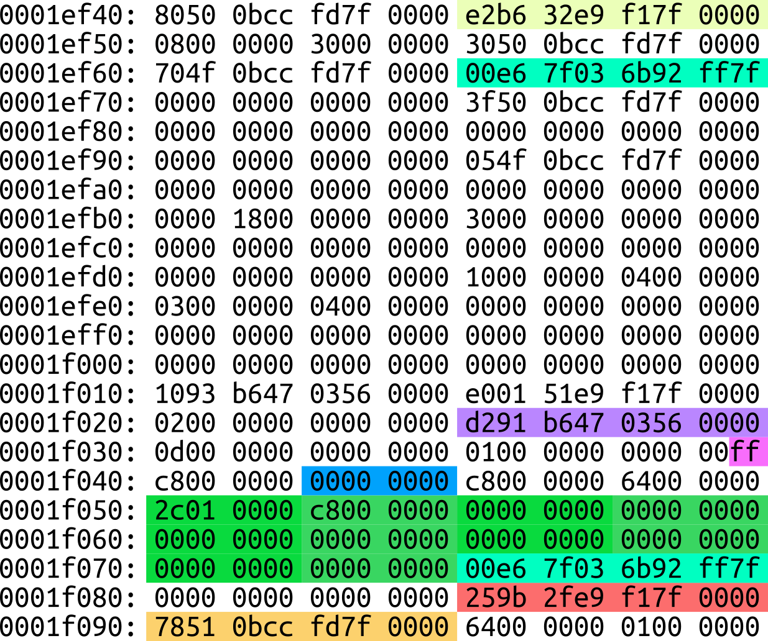

Slide 21

But the princess in another castle…
The program can jump anywhere we will it, but it won’t carry any data to the called function. On amd64 we pass data to functions via registers, which is a world away from the stack which we control
Notes:
But the princess is in another castle…

Slide 22
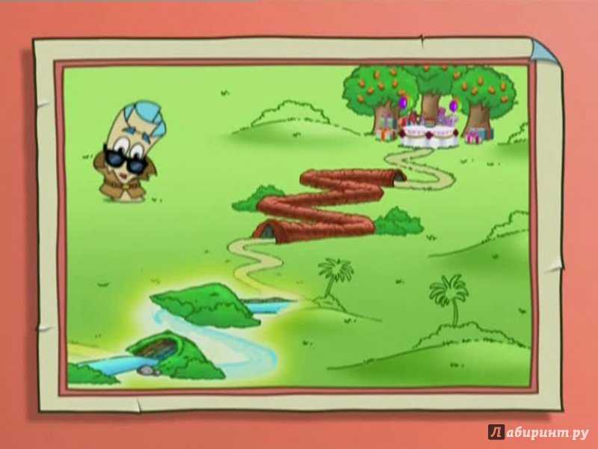
Taking a detour
So instead of going straight to the desired function, we’ll make a detour to some other procedures so that their epilogues would restock our registers with something more useful.
Notes:
Taking a detour

Slide 23
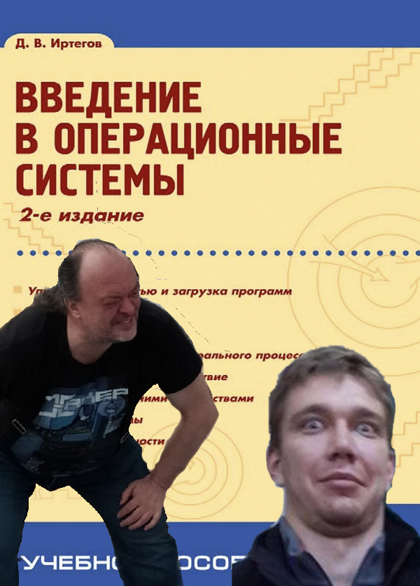
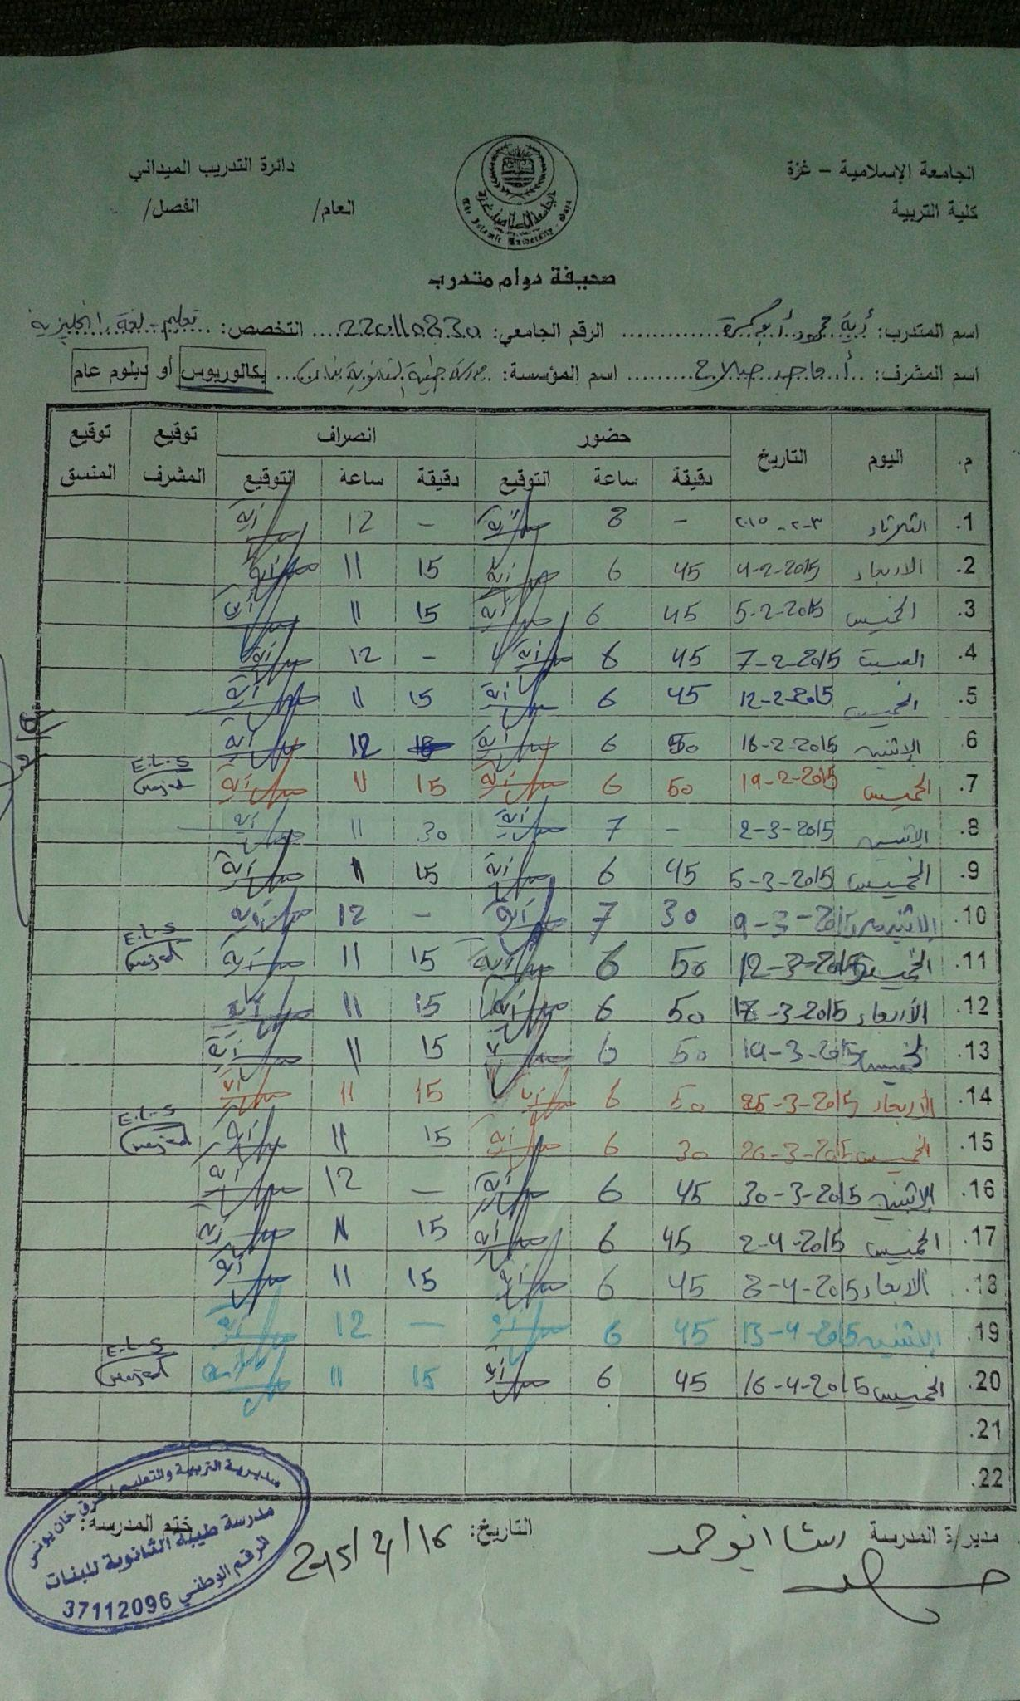
Notes:
Observe the wise ones

Slide 24

Supply and demand
Since we can choose where to jump, we may as well skip the unnecessary things and jump right to the end of some procedure.
Notes:
Supply and demand

Slide 25

Forging a chainmail
A sequence of instructions ending with ret is called a gadget, and we’re essentially linking them together to get what’s called a ROP chain, where ROP stands for return-oriented programming.

Slide 26
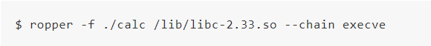
A quest for the missing link
The program we’ll use is called ropper. It’s written in Python and very easy to use:
Notes:
Ropper

Slide 27
Сюда надо будет вставить гифку или видос со скриптом, насколько я понял
Notes:
Demo

Slide 28
А тут много картинок со скриптом и их комментирование. Надо сюда этот
набор закинуть

Slide 29
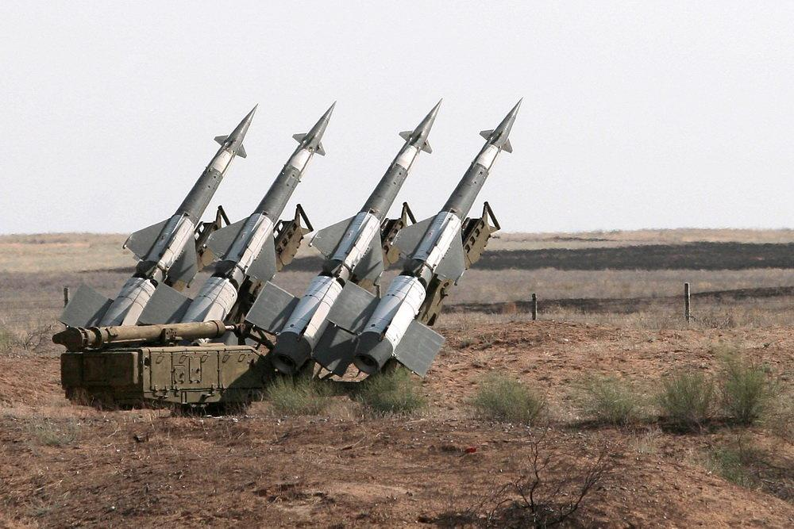
Defense measures

Slide 30

Isolation

Slide 31

Secret minimization

Slide 32
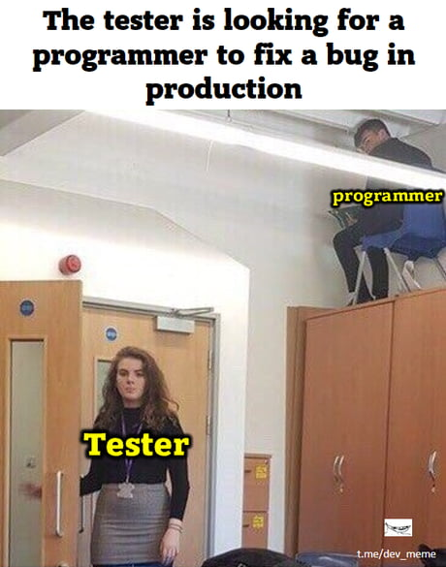
Audit

Slide 33

Using ready-made cryptographic systems

Slide 34
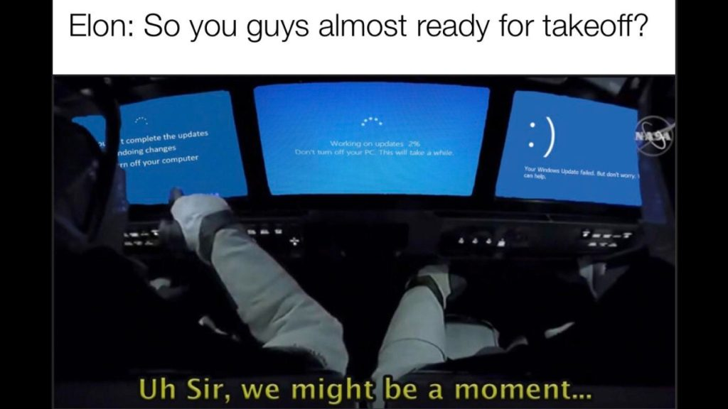
Updates

Slide 35
Тут QR коды на ссылки
Можно тут кто-нибудь эти ссылки напишет, или сразу QR зальет

